Slide 1


PROJECT
MILESTONE
By Edward Raphael & Harry Chiu
NAME OF PROJECT:
Lightning Modelling and Simulation in Python

Slide 2


03 | Objectives
04 | Descriptions
06 | Timeline & Gantt Chart
08 | Visualization
09 | Code Implementations
11 | Sources
Agenda

Slide 3


Objectives and Goals
Goal # 1
Goal # 2
Goal # 3
Simulate lightning formation using recursive fractal algorithms.
Integrate physical principles, particularly electric field influence.
Visualize natural lightning behavior with 2D plots and animations.
Goal # 4
Analyze behavior under environmental variations (e.g., pressure, humidity).

Slide 4
01
What Causes Lightning?
Collisions between the ice particles and water droplets causes there to be a separation of positive and negative charges. This buildup of said charges creates an electric field between the clouds and the ground strong enough to generate lightning. The lightning is produced once the field exceeds a certain threshold where air becomes ionized and plasma channels form.
02
Fractal Segment Construction:
• Midpoint: M = (A + B) / 2
• Normal Vector: n = [-(yB - yA), xB - xA] / ||...||
• Offset Midpoint: M' = M + offset * n
• Recursive Subdivision builds complexity (generations)
Branching Mechanics:
• Probability: branch if random() < p_branch
• Rotation Matrix: rotates branch direction R(θ)
• Segment Decay: L_new = L_old * decay_factor
Description

Slide 5
03
Tested Variables
Electric Field Approximation:
• E(y) = 1 - y / MAX_Y
• y: height of midpoint, MAX_Y: total canvas height
• Simulates stronger field near ground (y = 0)
Growth Constraint:
• Segment only forms if E(y) > E_threshold
• Branching only occurs in high-field zones
Purpose:
• Models lightning propagation toward ground
• Adds realism based on physics principles
Test Variables: generations, max_offset, decay_factor, E_THRESHOLD, p_branch.
Constants: MAX_Y = 200, angle ranges, random seed (for testing).
Computed
segment midpoints, normal vectors, field strength.
•Vary one test variable at a time and observe effects.

Slide 6
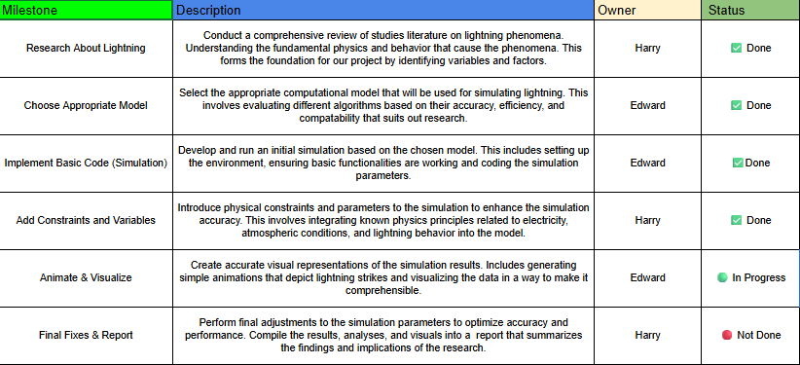
Timeline
05/10

Slide 7
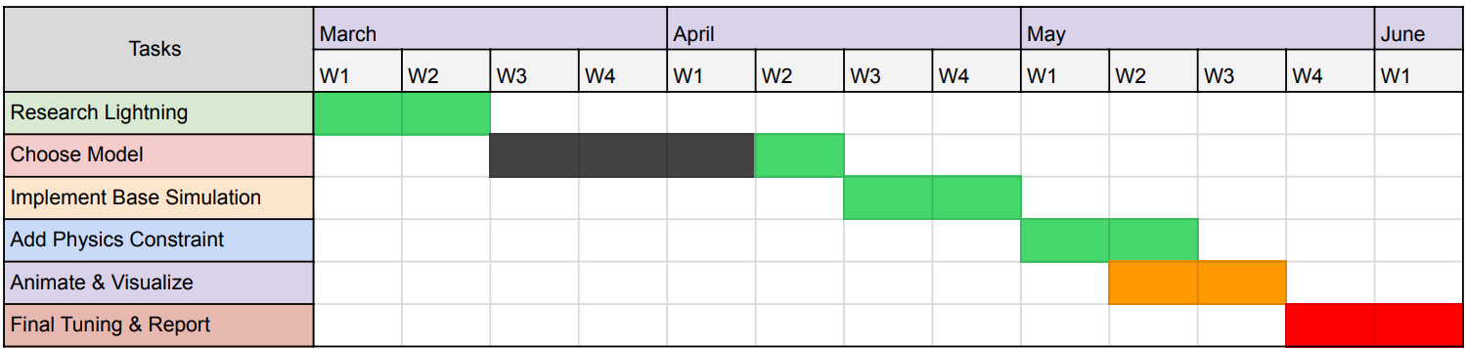
Gantt Chart
Display of our work timeline
Completed
In Progress
Not complete
Hiatus

Slide 8
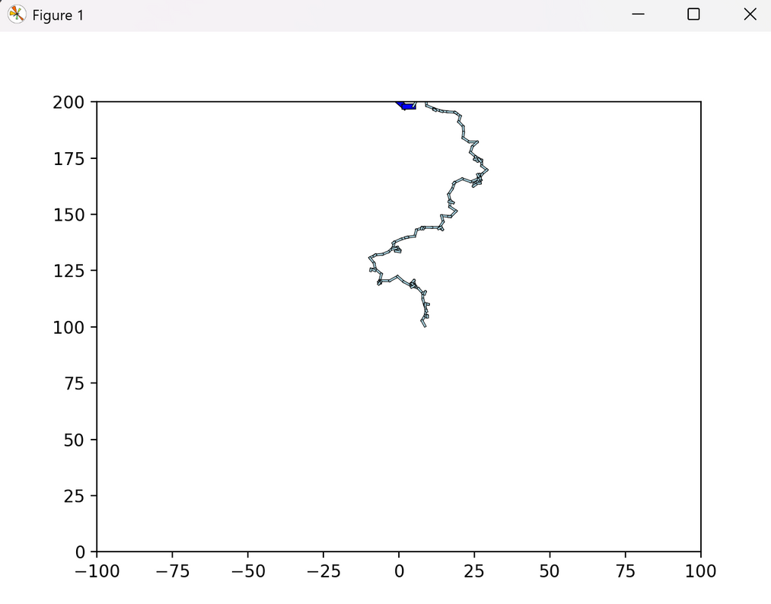
Visualizations

Slide 9
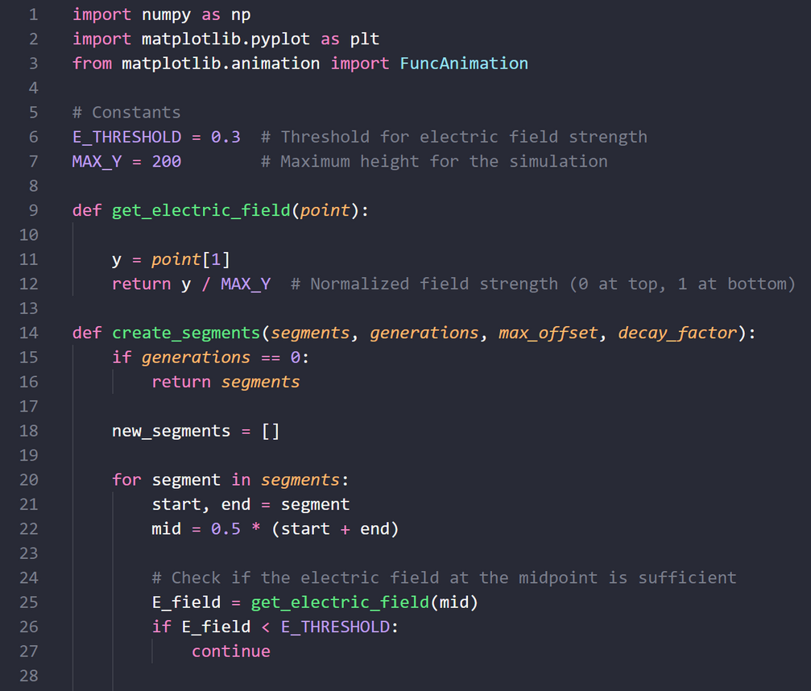
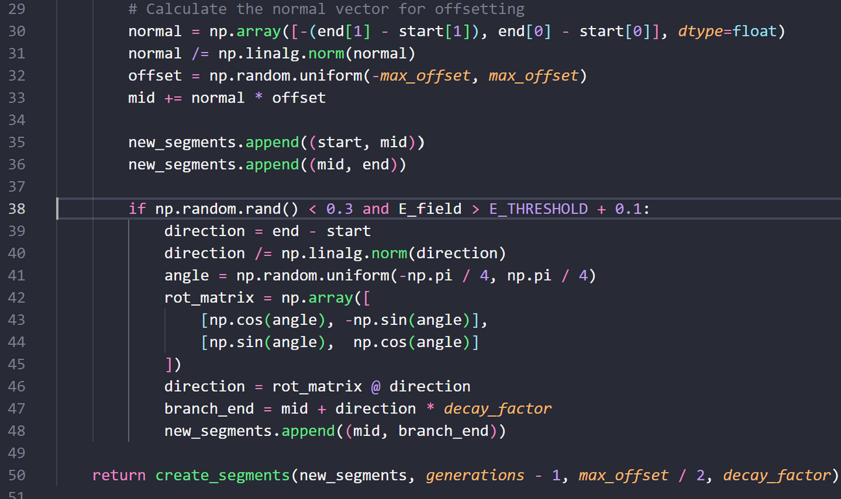
Program

Slide 10
Thank you

Slide 11

References
https://siliconwit.com/modelling-and-simulation-in-python/lightning-strike
Riousset, J. A., Pasko, V. P., Krehbiel, P. R., Thomas, R. J., & Rison, W. (2007). Three‐dimensional fractal modeling of intracloud lightning discharge in a New Mexico thunderstorm and comparison with lightning mapping observations. Journal of Geophysical Research Atmospheres, 112(D15). https://doi.org/10.1029/2006jd007621

